Slide 1
Model selection and diagnostics

Slide 2
todos
1. Recap
2. Apocrita: https://docs.hpc.qmul.ac.uk/intro/login/
3. CBB Seminar, next Weds 1300-1500
4. LERN Big Data debate, next Thurs 1800+
5. Solutions to exercises

Slide 3
Model criticism and choice
Model selection
Assumptions of GLMs
Independence
Testing the other assumptions
Solutions to model problems

Slide 4
Principles for Model Choice
If we have multiple explanatory variables, we often need to make choices about which models to investigate, and which models to present in papers, and to rely on in reaching conclusions, in estimation etc.
‘There are three main principles of model choice:
economy of variables
multiplicity of p-values
preserve marginality

Slide 5
Economy of variables
“the simpler the better”:
You should pick the simplest model that adequately explains the response
Models should have as few parameters as possible
Simple relationships between variables are preferred (linear, no interaction)
Models should be simplified to only include terms that are necessary. This is called a
Minimum adequate model

Slide 6
Multiplicity of p-values
We have already seen that “p = 0.05” is not a magic wand.
It simply means Pr(x ≥ x_{crit} | H₀)
But H₀ may or may not be true. Worse than this, multiple tests compound this as:
P_{type-1} = 1-(1-a)^{k} for k tests at level a

Slide 7
Marginality
Marginality is about making sure that your tests are invariant to linear transformations of the data: e.g. If you halve all of the observations, the F-ratio will be identical. Don’t worry too much about this, but preserving marginality means that:
main effects must precede interactions that involve the term in the model formula
If an interaction is significant, the main effects involved are important and should be retained, irrespective of significance
Do not test main effects for a term with a SS adjusted for an interaction involving the term

Slide 8
Options for selecting a model
Automated model choice: fit a model with all terms and let a software algorithm do the model selection for you
Start with a model with all terms and remove non-significant terms yourself
“All subsets”: analyse all possible variants and choose one
“Enlightened” model choice – use your knowledge of the system to select a small number of candidate models and select the best one.
Multi-model inference - fit a selection of possible models and calculate coefficients based on all models, weighted by how likely they are

Slide 9
Automated model Choice
A popular choice for choosing models, particularly in multiple regression (i.e. Multiple continuous explanatory variables, no categorical variables) is automated model choice, particularly stepwise regression
In FORWARDS stepwise regression, we start with single-factor models, and at each step add the variable with the highest F-ratio or lowest p-value. This process continues until no factors are sufficiently informative to pass a F-ratio/p-value cut-off. This is then the preferred model
In BACKWARDS stepwise regression, we start with all factors in the model, and remove factors with the highest p-values/lowest F-ratios in turn.

Slide 10
Problems with automated model choice
Focuses on purely STATISTICAL issues in model choice. Often scientific/practical issues are just as, if not more, important
Different approaches give different ‘best models’ – subjective choice between them, may not return best fitting model in any statistical sense
Lots of p-values: could include factors by chance
(I think) most statisticians would advise against these automated methods

Slide 11
Non-automated model choice
Has the same problems as automated procedures if you just follow a rule
Allows subjective decisions about whether to keep important terms in the model if you think while you do it
Allows model simplification by collapsing multiple levels of factors when they don’t have an effect

Slide 12
All subsets analysis
Can be useful when there are a few terms in the model
When there are lots of terms can become very unwieldy

Slide 13
“Enlightened” choice
Avoids lots of the problems associated with stepwise model selection
Can lead to unimportant terms being included
Favoured by lots of statisticians
Only really useful when you have a good idea of what’s going on in the system.

Slide 14
Which to use?
No simple answer.
When you know a reasonable amount about what is likely to be important and what isn’t then use the approach where you select a few candidate models and compare them
When you are doing more exploratory analysis then use a stepwise approach
NB the above is only my opinion

Slide 15
p-values vs AIC
Two common approaches to comparing the goodness of fit between models
Compare two models using an F-test, a likelihood-ratio test or similar. If one model gives a significant reduction in explanatory power discard it.
Compare models using information-theory criteria such as AIC (Akaike Information Criterion).

Slide 16
p-values
To decide whether to retain a term in a GLM, fit a model containing the term and then carry out a “deletion test”
remove the term in question from the model and compare the goodness of fit of models with and without the term using a partial F-test
In R you can do this using the drop1() function. This will only give results for terms whose removal doesn’t violate marginality (i.e. it won’t give you a result for a main effect when the term is also present in an interaction term).
For an “ordinary” GLM specify an F-test to compare models e.g.
drop1(mymodel,test="F")

Slide 17
AIC
AIC is defined as:
Where k is the number of explanatory variables and L is the maximised likelihood of the model
The preferred model is the one with the lowest AIC value
As a rule of thumb, if two models have AIC values that differ by 2 or less then we cannot distinguish between them: they are both equally good descriptors of the data

Slide 18
Assumptions of the GLM
height_{i} = α + β.rainfall_{i} + γ.elevation_{i} + ε
In each case, ε is independently sampled from a normal distribution with mean 0 and standard deviation s (estimated from the data) for every y
This formula tells us everything we need to know about the assumptions of GLM:
the error for each data point is independent
the standard deviation of the error is the same in every case
The errors are normally distributed
The relationship between covariates and response is linear and additive

Slide 19
Assumptions of GLM
We will discuss each of these four assumptions in turn:
Independence
Normality of error
Homogeneity of variance
Linearity/additivity

Slide 20
Independence
In many ways, independence is the most fundamental of the GLM assumptions
Formal definition: Data points are independent if knowing the error of one datapoint tells us nothing about the error of any other datapoint
Independence is a matter of experimental design
Effects of many forms of non-independence on tests are (a) unpredictable and (b) unfixable!

Slide 21
Normality of Error
There are two main approaches to testing for normality:
Graphical approaches:
Histogram of residuals
Normal quantile-quantile plot
Formal tests for normality.

Slide 22
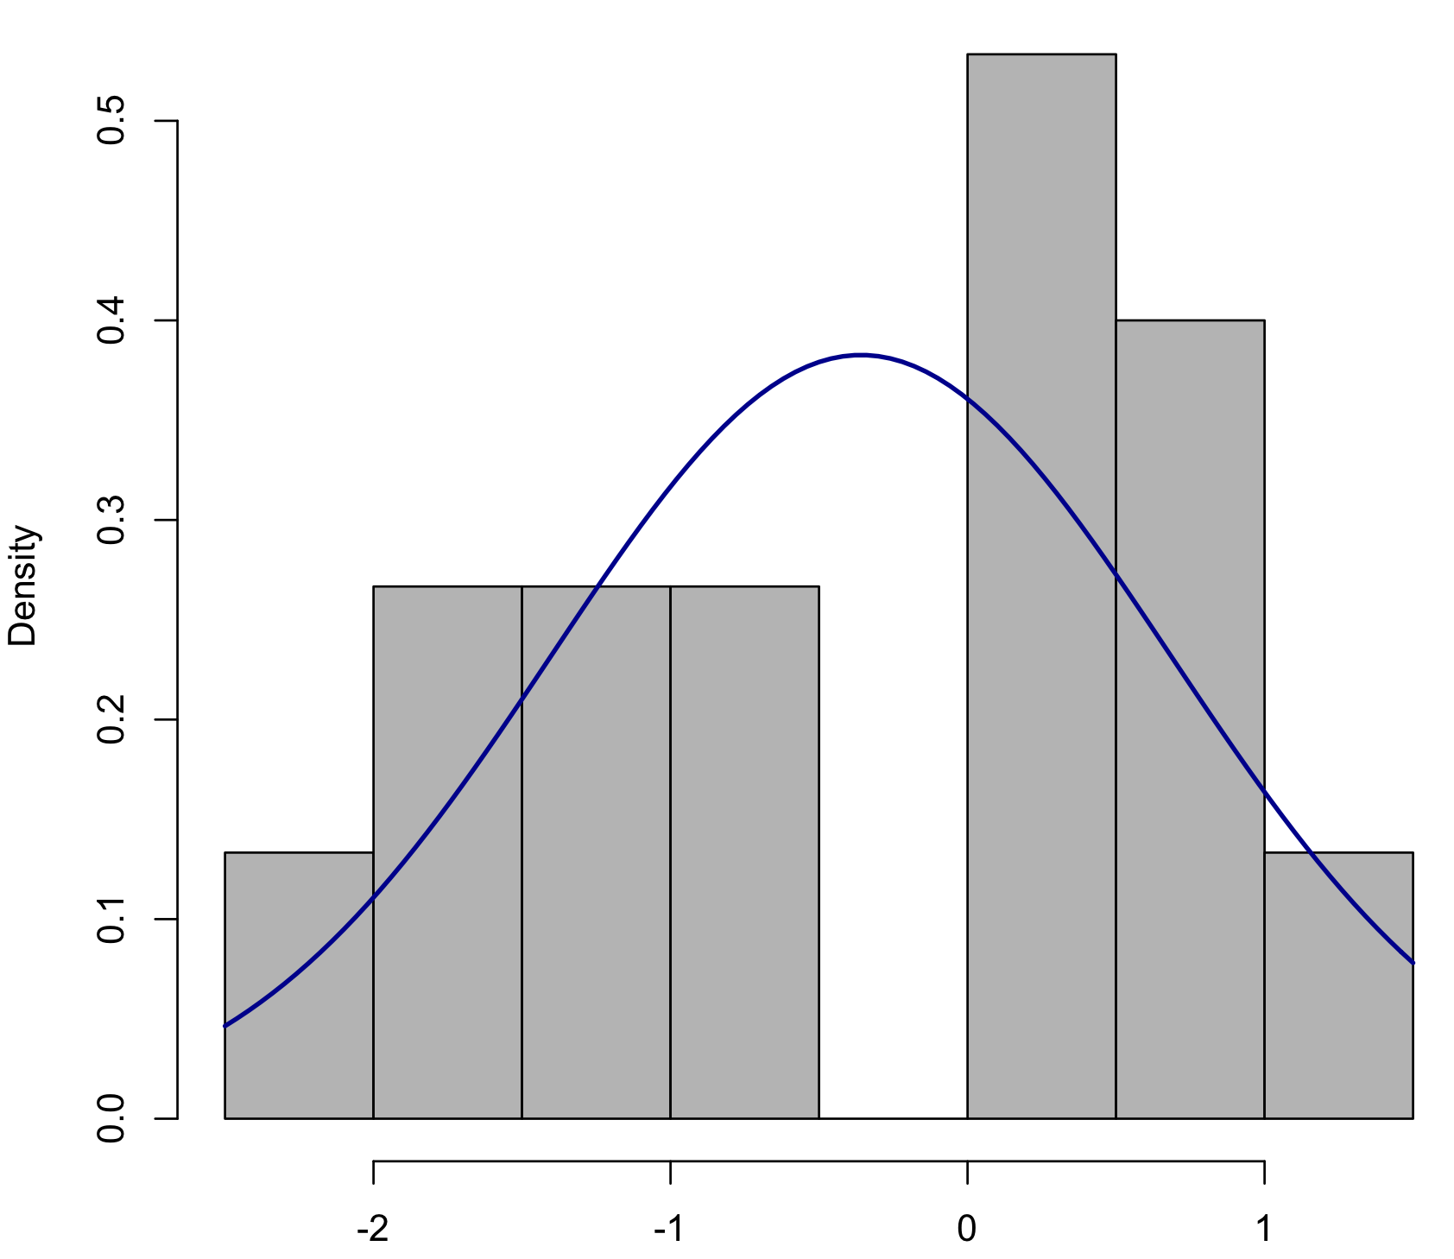
Normality of Error
Is this something to be worried about?

Slide 23
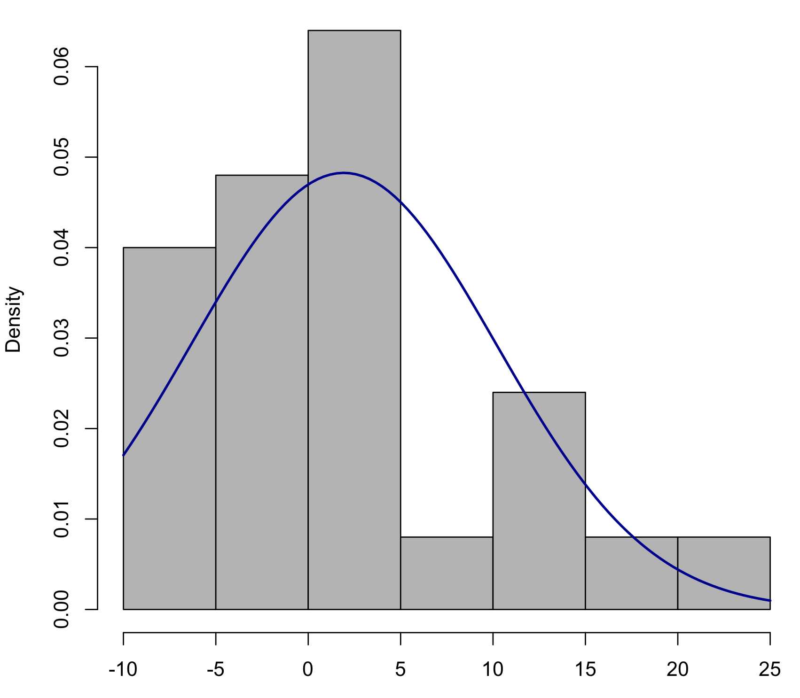
Normality of Error
Is this something to be worried about?

Slide 24
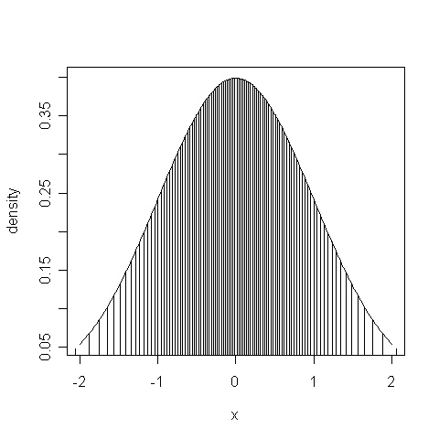
Q-Q plot
For a more sensitive look at the distribution of residuals, we plot our standardised residuals in ascending order along one axis, with the appropriate quantiles of a normal distribution on the other axis
If the data follows a normal distribution, the resulting plot should be a
straight line

Slide 25
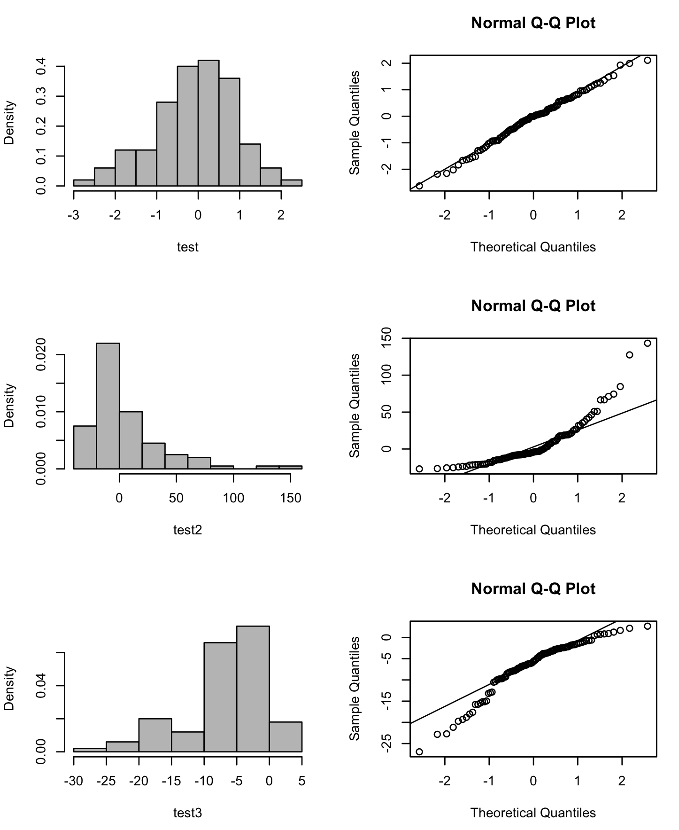
Normality of Error

Slide 26
Formal tests for normality
A number of tests exist for whether a set of residuals significantly departs from a normal distribution. The most common is the Shapiro-Wilks test.
There are a variety of these:
Anderson-Darling test
Ryan-Joiner test
Kolmogorov-Smirnov test

Slide 27
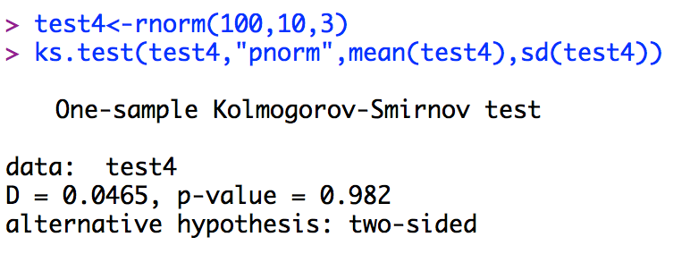
Formal tests for normality

Slide 28
Homogeneity of Variance
This also has a fancy statistical name – homoscedasticity
A different graphical approach can help diagnose heteroscedasticity. Plotting residuals (or standardised residuals) against fitted values.
Also formal tests for homogeneity of variance for many circumstances

Slide 29
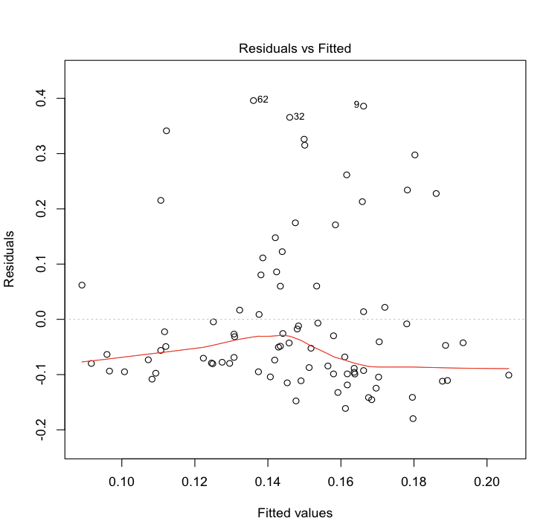
Homogeneity of Variance

Slide 30
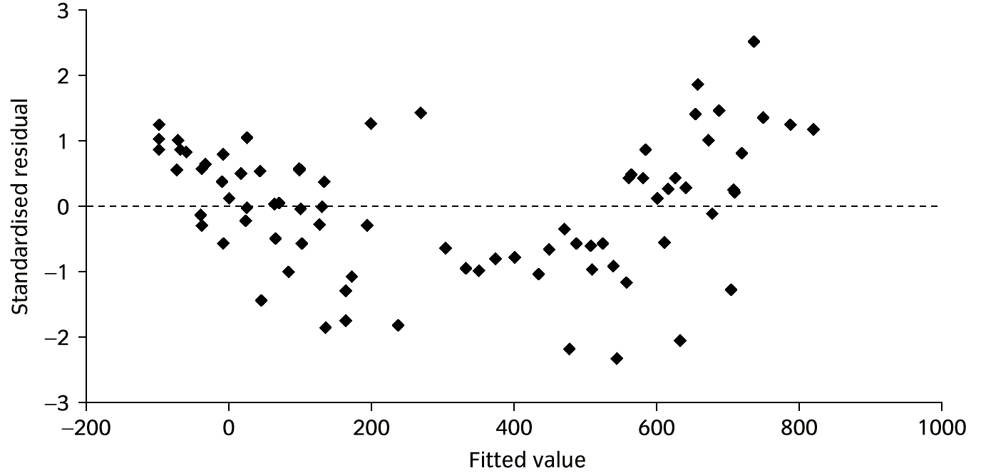
Linearity
Plotting residuals (or standardised residuals) against fitted values can also help with diagnosing departures from linearity. If the points on this graph seem curved, then there may be a non-linear relationship between one or more explanatory variable and the response:

Slide 31
Formal tests for heteroscedasticity
You have already used a test for homoscedasticity that applies in this simplest case, perhaps without realising it: the F-test.
Recall that the F-test in an ANOVA table is testing whether the variance explained by part of the model (MS for a particular factor) is greater than that due to error (error MS). This is testing whether two variances are significantly different, and we can use the same test to compare variances between groups in our data.

Slide 32
Formal tests for heteroscedasticity
Other tests generalise this to multiple levels of a factor, and are thought to be more sensitive, more robust (e.g. to lack of normality), or both:
Levene’s test
Bartlett’s test
Brown-Forsythe test

Slide 33
Formal tests vs. plots of residuals
Statistics texts (and, indeed, statisticians) are somewhat divided over whether graphical approaches or formal statistical tests are to be preferred, but I think most do not recommend formal hypothesis tests in this context.
This seems counter-intuitive – surely an objective and powerful test is preferable to assessing things ‘by eye’?

Slide 34
Problems with formal tests
What is the meaning of a non-significant p-value? p-value is:
p( data |null is true).
A high (insignificant) p-value doesn’t mean the null hypothesis is, or even is likely to be true.. e.g. depends on power, and so on sample size.
A significant p-value just tells you that the residuals are non-normal/heteroscedastic. Not how large the departure from assumptions is.
Certainly not how important the departure is, in terms of how much it will effect the statistical test you are using

Slide 35
Problems with formal tests
Formal tests are very powerful at detecting departures from normality/ homoscedasticity
but GLM methods are quite robust to departures from these assumptions – particularly to non-normality.
Depends on the distribution – very asymmetric distributions can be problematic
Depends on how balanced the design is
Depends on size of effect
Depends on sample size: for sample size >30, GLM is pretty robust. Of course a big sample size means a test ismore likely to reject normality!

Slide 36
Always look at the plots of residuals
Even if you decide to rely on formal tests of assumptions, you should get in the habit of always looking diagnostic plots of residuals.
R will produce them for you nicely
To reiterate:
For every model you fit, look at:
histogram or qqplot of residuals
Residuals vs fitted values

Slide 37
Solutions to problems
Transform variables
Use tests with different, appropriate assumptions (next lecture)
Use robust (often non-parametric) methods
(for non-linearity) use models with polynomial terms

Slide 38
Solving non-linearity
Possible options:
Log transform the response variable
Introduce a polynomial term into the model
Introduce an appropriate interaction term into the model
Generalised additive models
Measure more explanatory variables

Slide 39

GLM is a (fairly) robust method
One of the most important things to bear in mind is:
While its good statistical practice to perform model criticism, it’s too easy to push the ‘panic button’ and beat your badly behaved data with transformations, or reach the most exotic weapon in your statistical armoury.

Slide 40
GLM is a (fairly) robust method
GLM (and so ANOVA, regression) has been demonstrated to be fairly robust to departures from its assumptions
Significant departures are not necessarily important!
there are problems with statistical tests of assumptions
More complex methods are often more sensitive to violations of assumptions..
You need to develop statistical wisdom, as well as knowledge!

Slide 41
Summary
Model choice is mostly about finding a minimal adequate model for your data
But we must preserve marginality, and for designed experiments you might need to retain some parameters
should always test if data matches assumptions of GLM – graphical approaches are (probably) better
often, simple transformations can help fix problems
If this fails, try e.g. Box-Cox, look for robust methods, or methods with other assumptions
DON’T BE TOO PICKY – GLM IS QUITE ROBUST

